Slide 1
Jaundice with upper abdominal pain 1WK
Fever & rigor

Slide 2
LAB TEST
TSB | 1.6mgldl
D | 1.3 mgldl
ALP | 329 U/L
ALT | 72 U/L
AST | 52 U/L
INR | 1.0

Slide 3
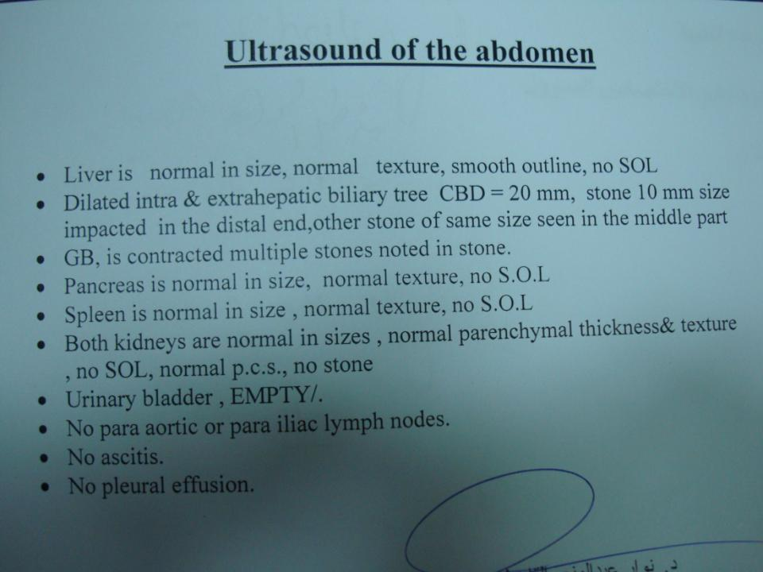

Slide 5
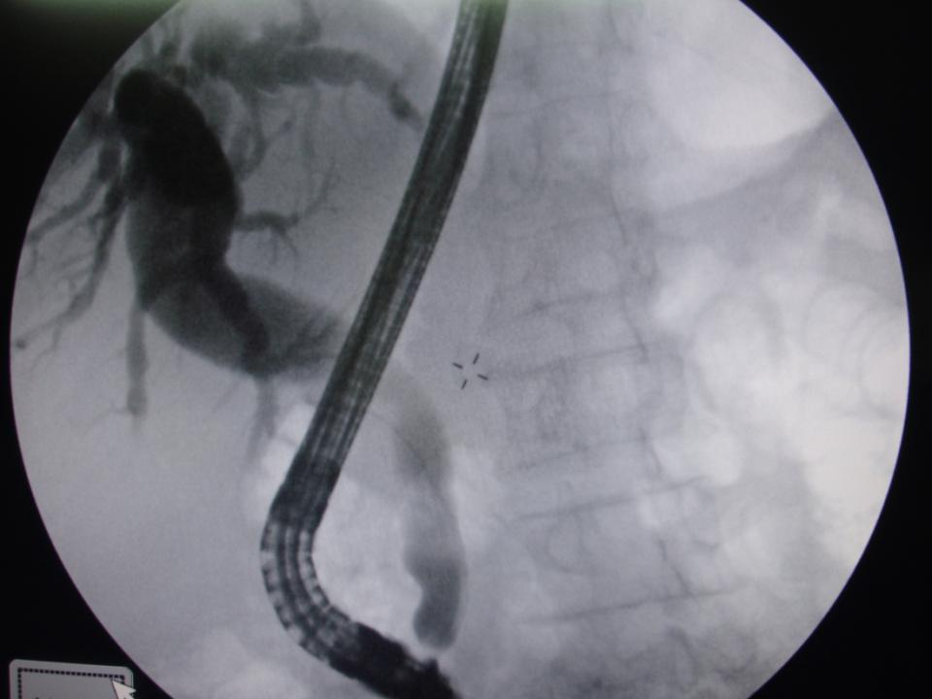

Slide 6
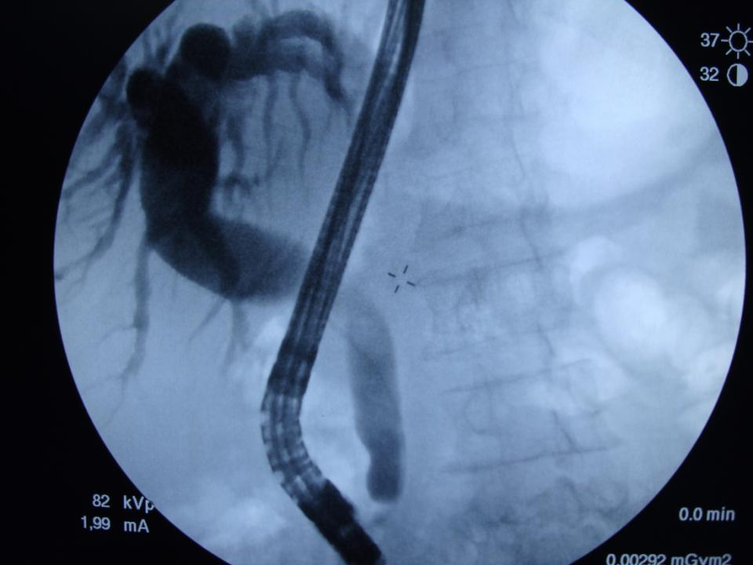

Slide 7
