Slide 1
بهية كريم مهلهل 70 سنة الناصرية
RT. Hypochondrial pain with fever for 10 days duration associated with nausea
No jaundice
No wt. loss

Slide 2
LAB TEST | RESULTS
CBP | Normal
TSB | 1.2 mg/dl
D | 0.8 mg/dl
ALT | 10 u/l
AST | 12 u/l
ALP | 82 u/l
INR | 1.1
Virology | Negative

Slide 4
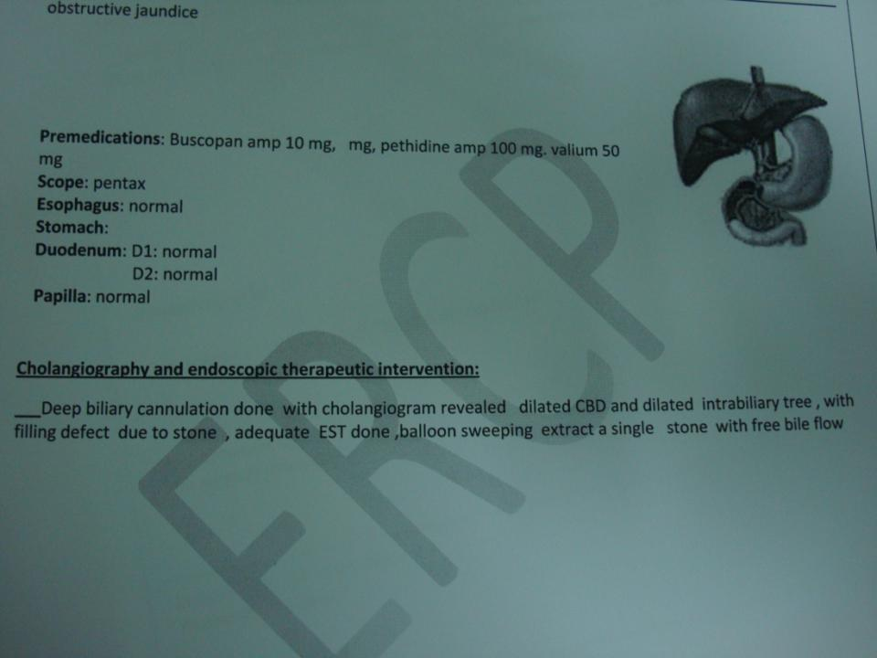

Slide 5
