Slide 1
Repeated vomting & abdominal pain for 1 mon duration

Slide 2
LAB TEST | RESULT
TSB | 0.5 mg/dl
D | 0.3 mg/dl
SGOT | 32 u/l
SGPT | 47 u/l
ALP | 462 U/L
INR | 1.1

Slide 3
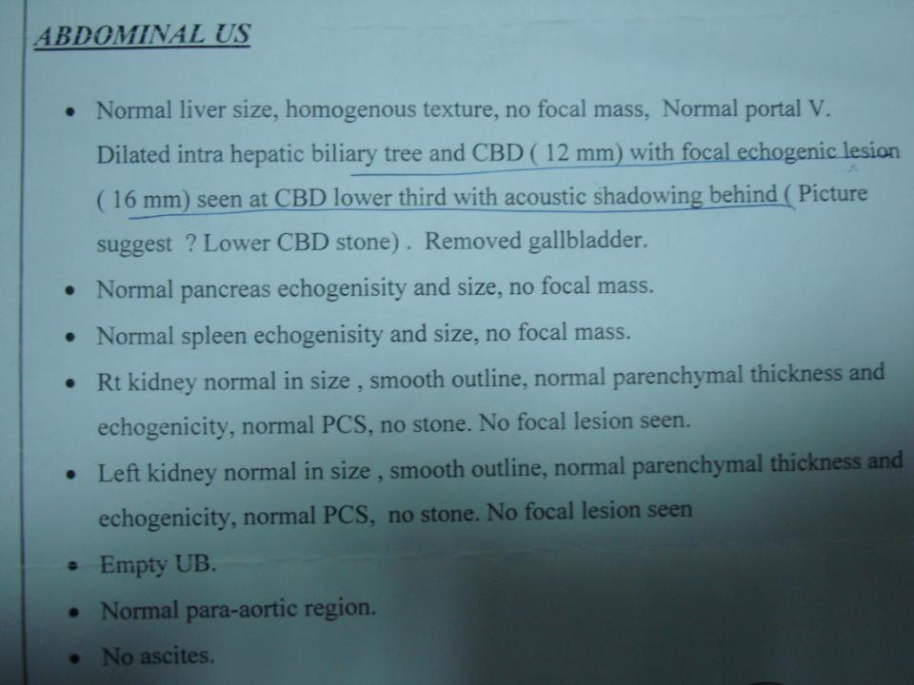

Slide 4
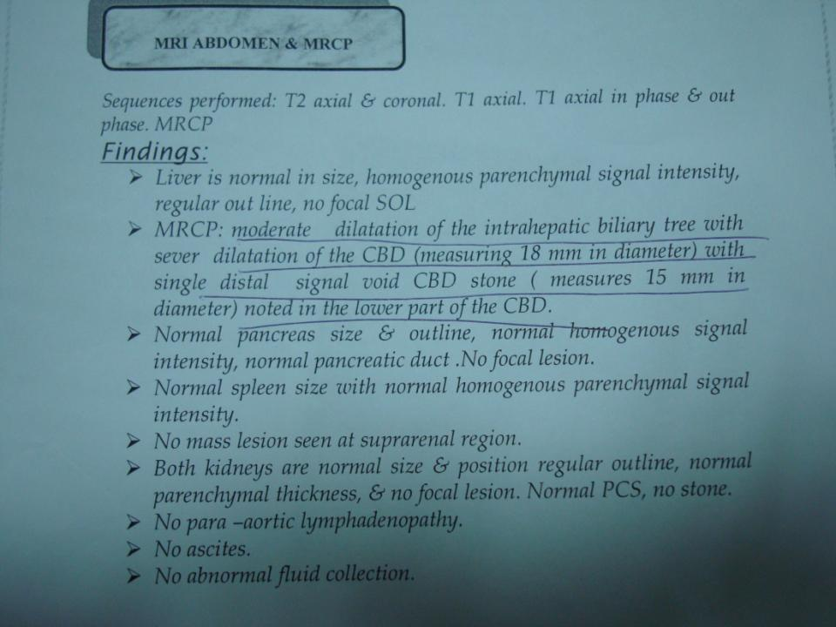

Slide 5
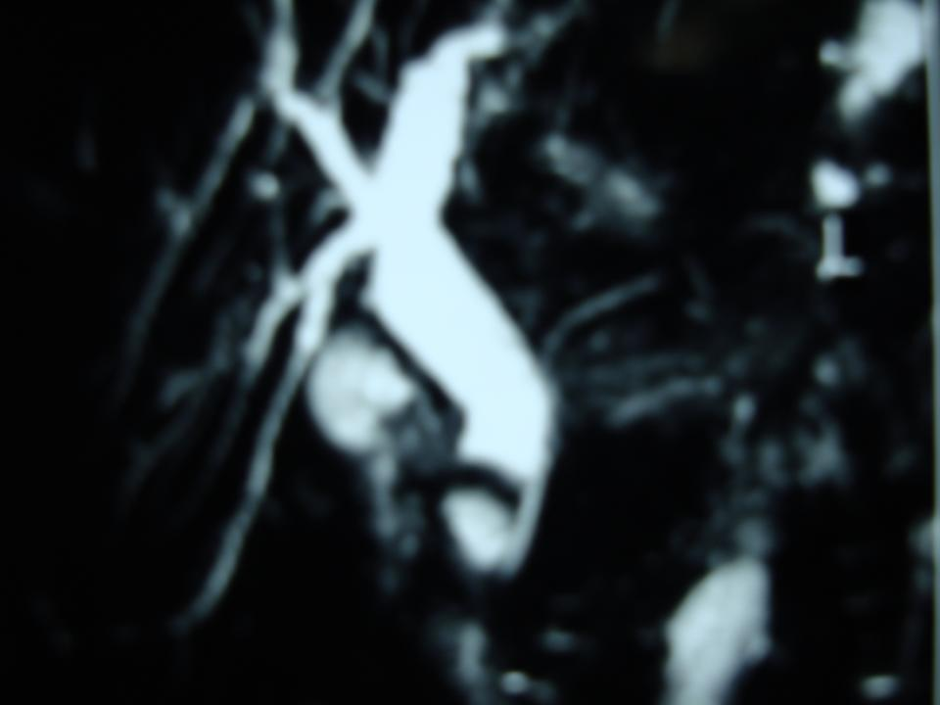

Slide 6
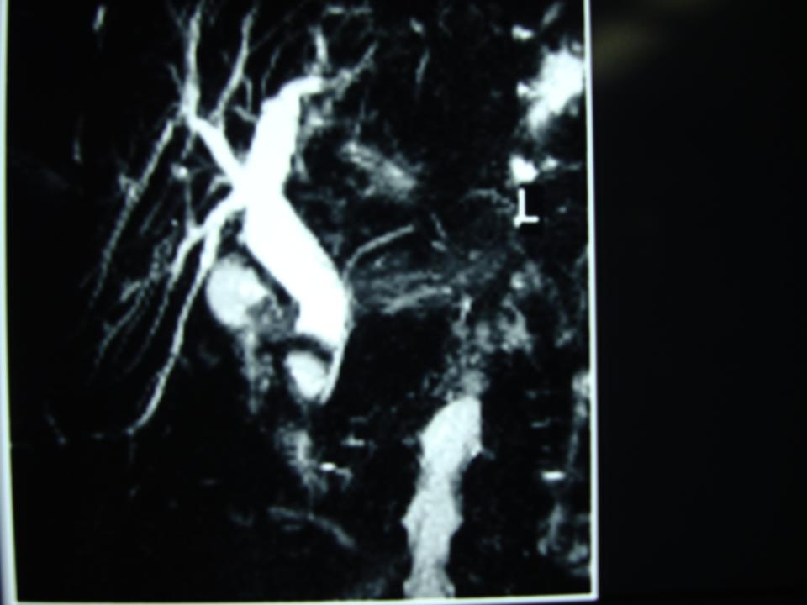

Slide 8
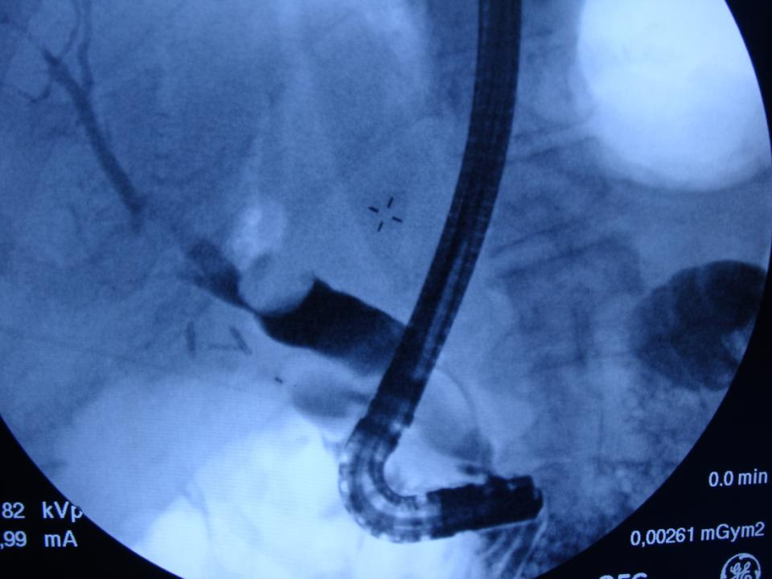

Slide 9
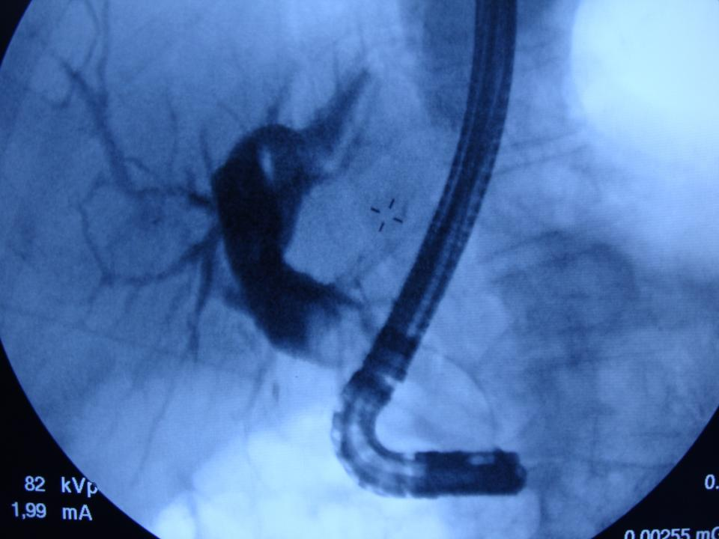

Slide 10
