Slide 1
Obstructive jaundice with upper abdominal pain for 2 week duration .
No fever
Associated with nausea & some times vomiting

Slide 2
LAB TEST | RESULTS
CBP | Normal
INR | 1.0
TSB | 10.77 mg/dl
D | 8.15 mg/dl
ALP | 325 u/l
ALT | 160 u/l
AST | 510 u/l
Virology | Negative

Slide 4
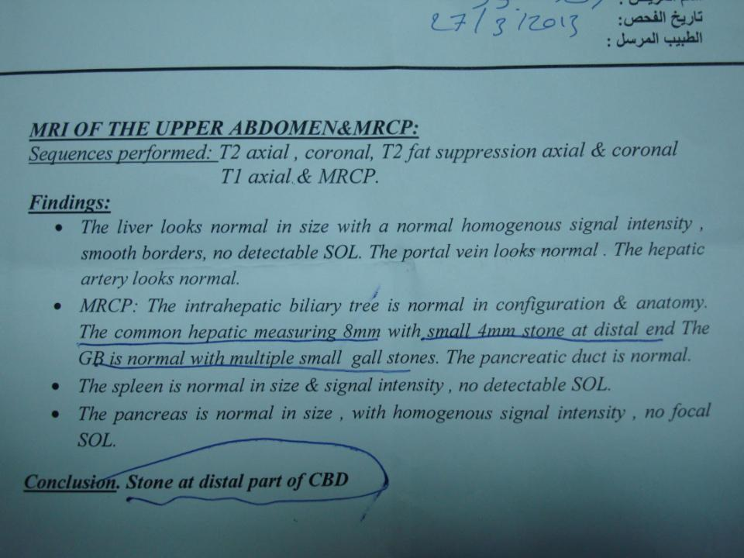

Slide 5
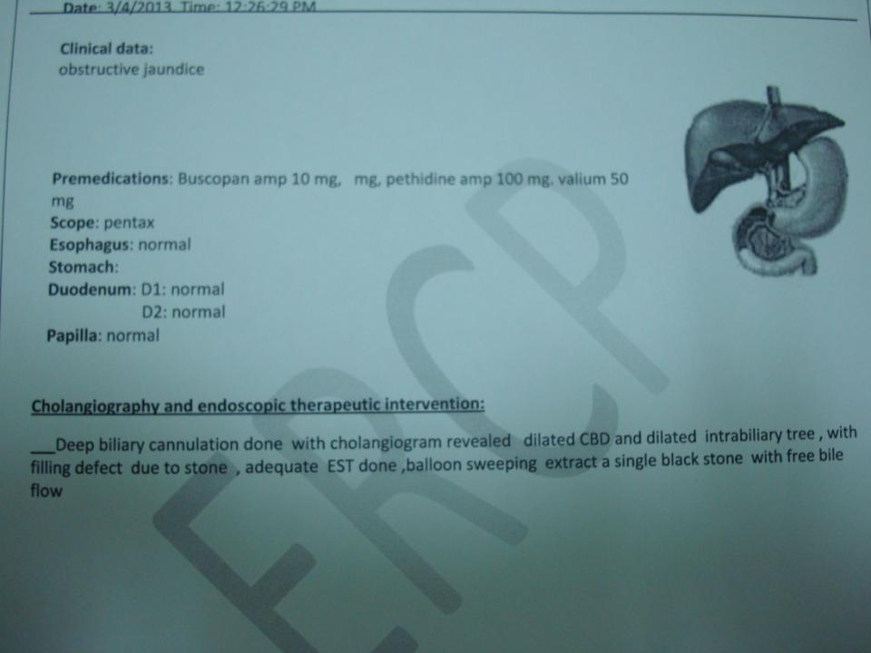

Slide 6
