Slide 1
Colicky upper abdominal pain for 1WK
Vomting assocaited with jaundice.

Slide 2
LAB TEST | RESULT
TSB | 2.3 mg/dl
D | 2.1 mg/dl
SGOT | 94 u/l
SGPT | 89 u/l
ALP | 26 U/L

Slide 3
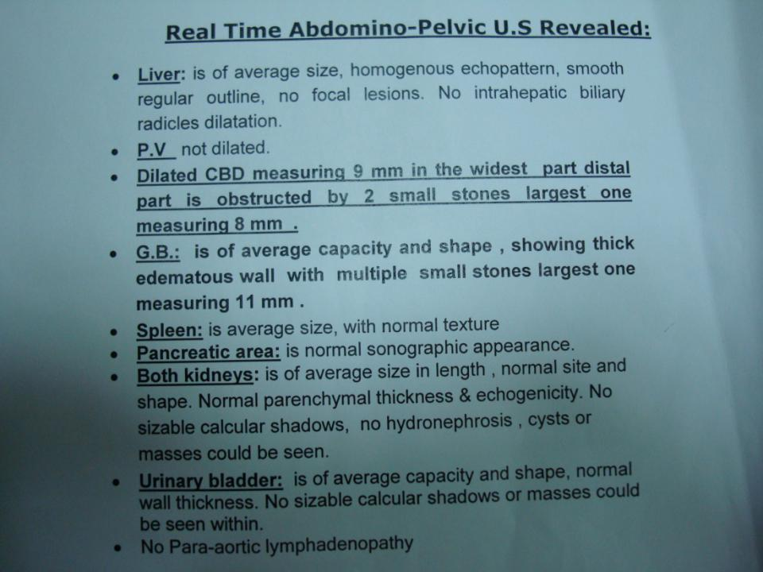

Slide 4
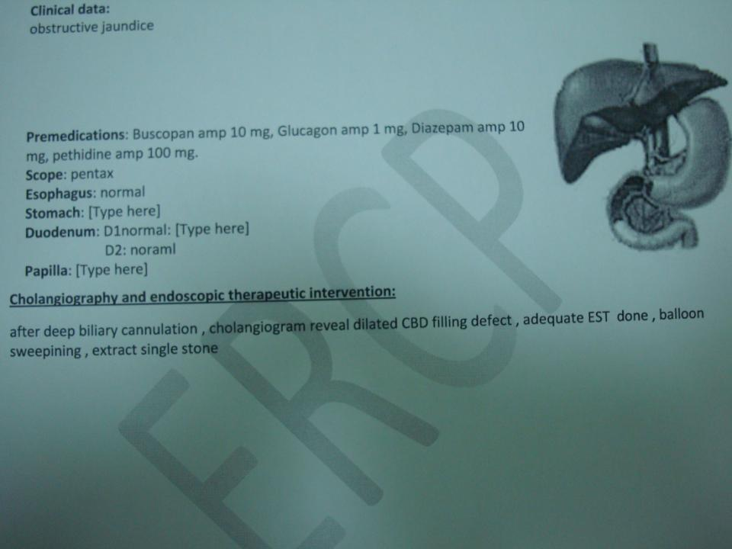

Slide 5
