Slide 1
Upper abdominal pain for 1 week
No jaundice
No fever

Slide 2
Lab test | Result
TSB | 0.6 mg/dl
D | 0.1 mg/dl
ALP | 112U/L
ALT | 37 U/L
AST | 17 U/L
INR | 1.0

Slide 5
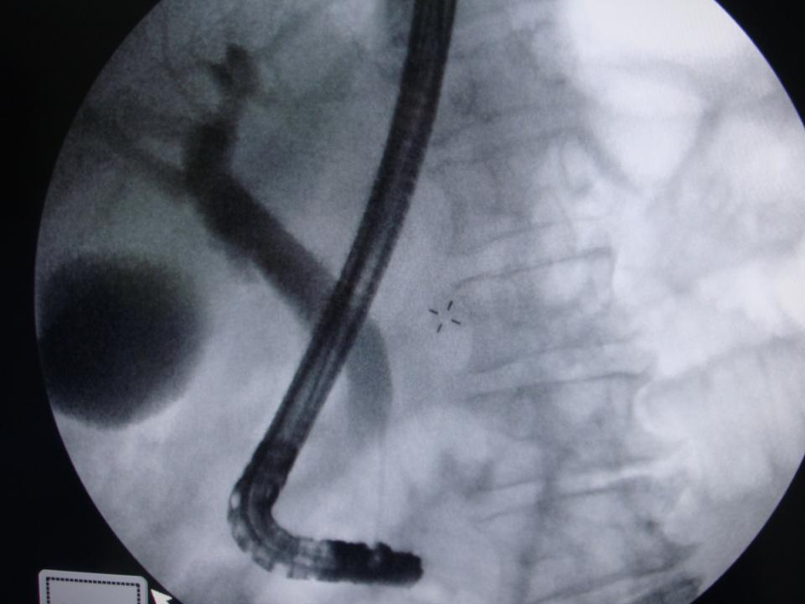

Slide 6
