Slide 1
Obstructive jaundice for 3 mon with itching & wt.loss

Slide 2
Test | Result
Hb | 12.3 mg/dl
WBC | 15.3
PLT | 654 U/L
TSB | 30.7 mg/dl
D | 29.5 mg/dl
ALP | 243
AST | 75
ALT | 83

Slide 3
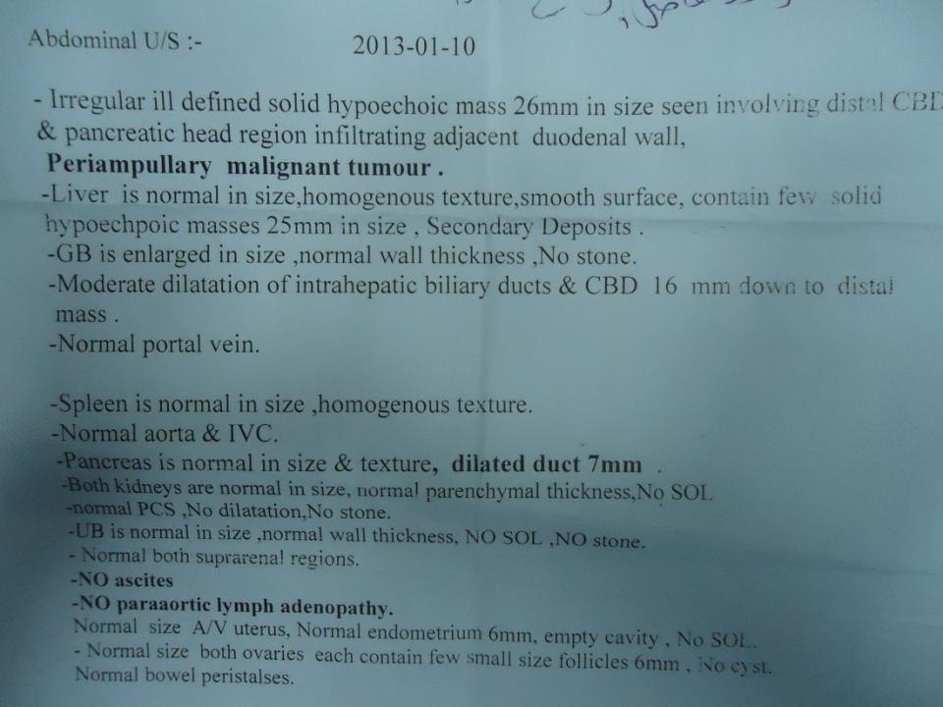

Slide 4
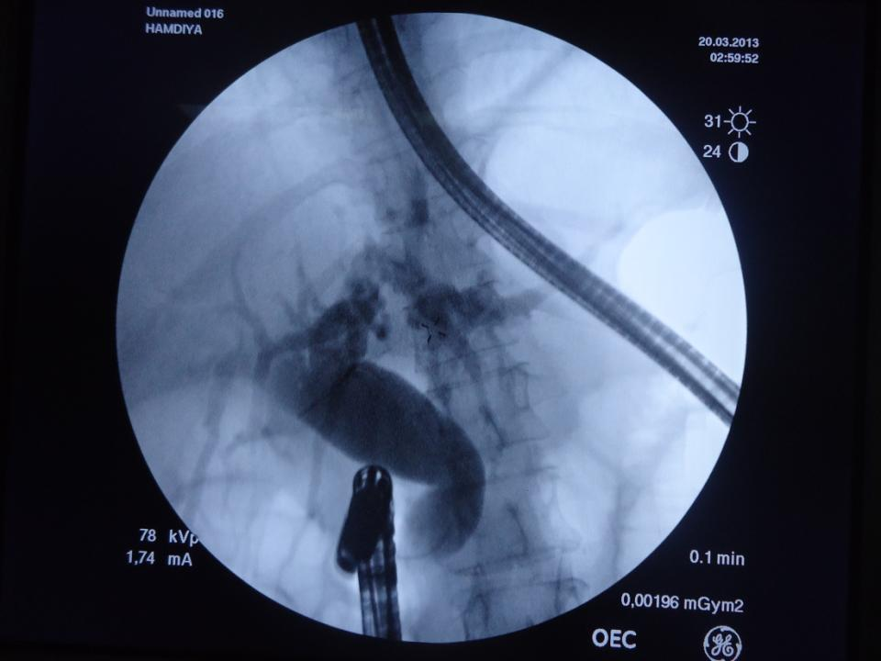

Slide 5
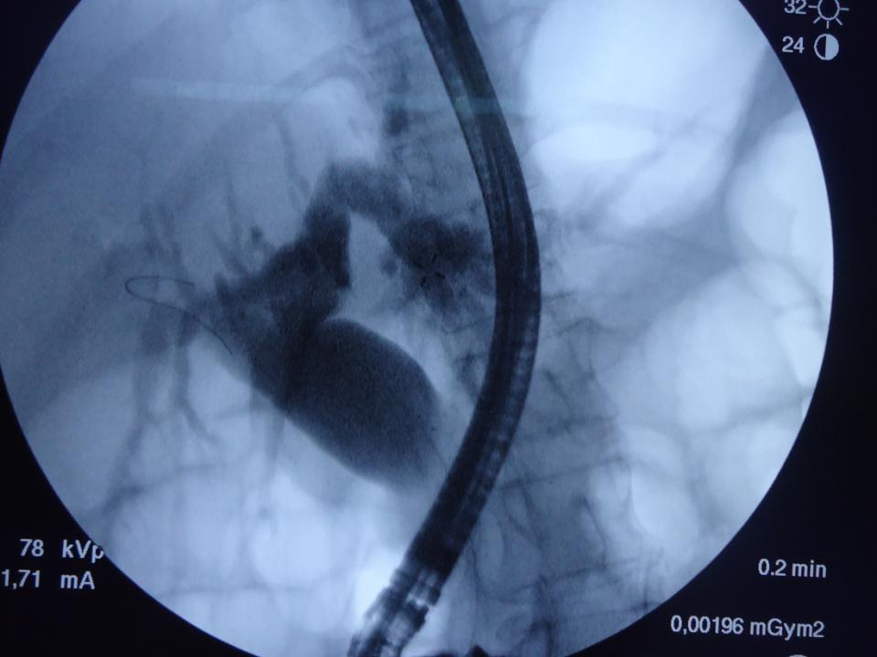

Slide 6
