Slide 1
RT.hypochondrial pain , obstructive jaundice and vomting 2 wk duration.

Slide 2
Test | Result
TSB | 7.7mg/dl
D | 7.4mg/dl
ALP | 779 U/L
SGOT | 331
SGPT | 245
WBC | 10.4
Hb | 15mg/dl
PLT | 284
INR | 1.0
Virology | Negative

Slide 4
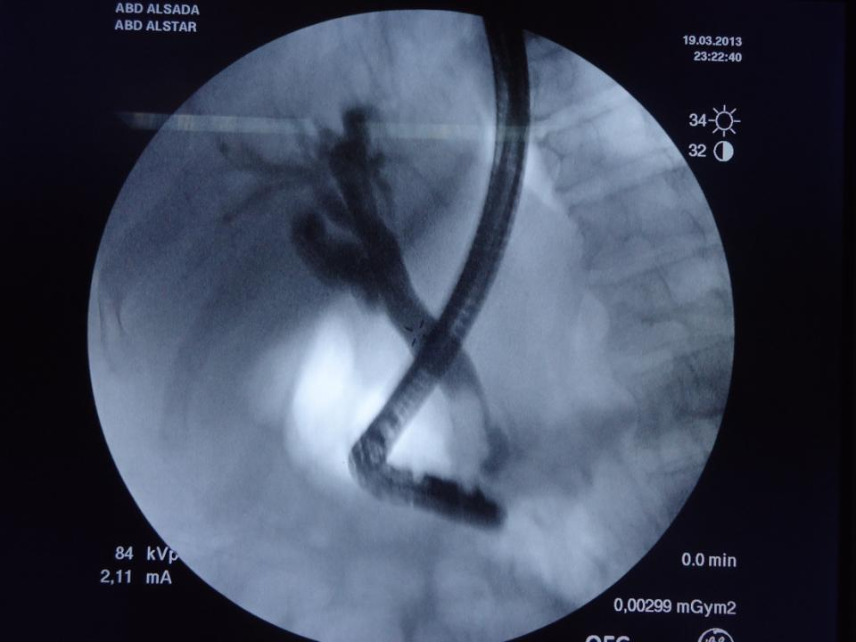

Slide 5
